Slide 1




Near-Real-Time Object Recognition using Azure AI and Microsoft Fabric
Sai Prudhvi Neelakantam

Slide 2








THANKS TO AMAZING SPONSORS
Awesome Partner
Platinum
Gold
Bronze

Slide 3
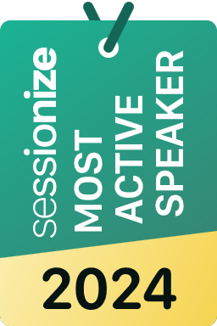
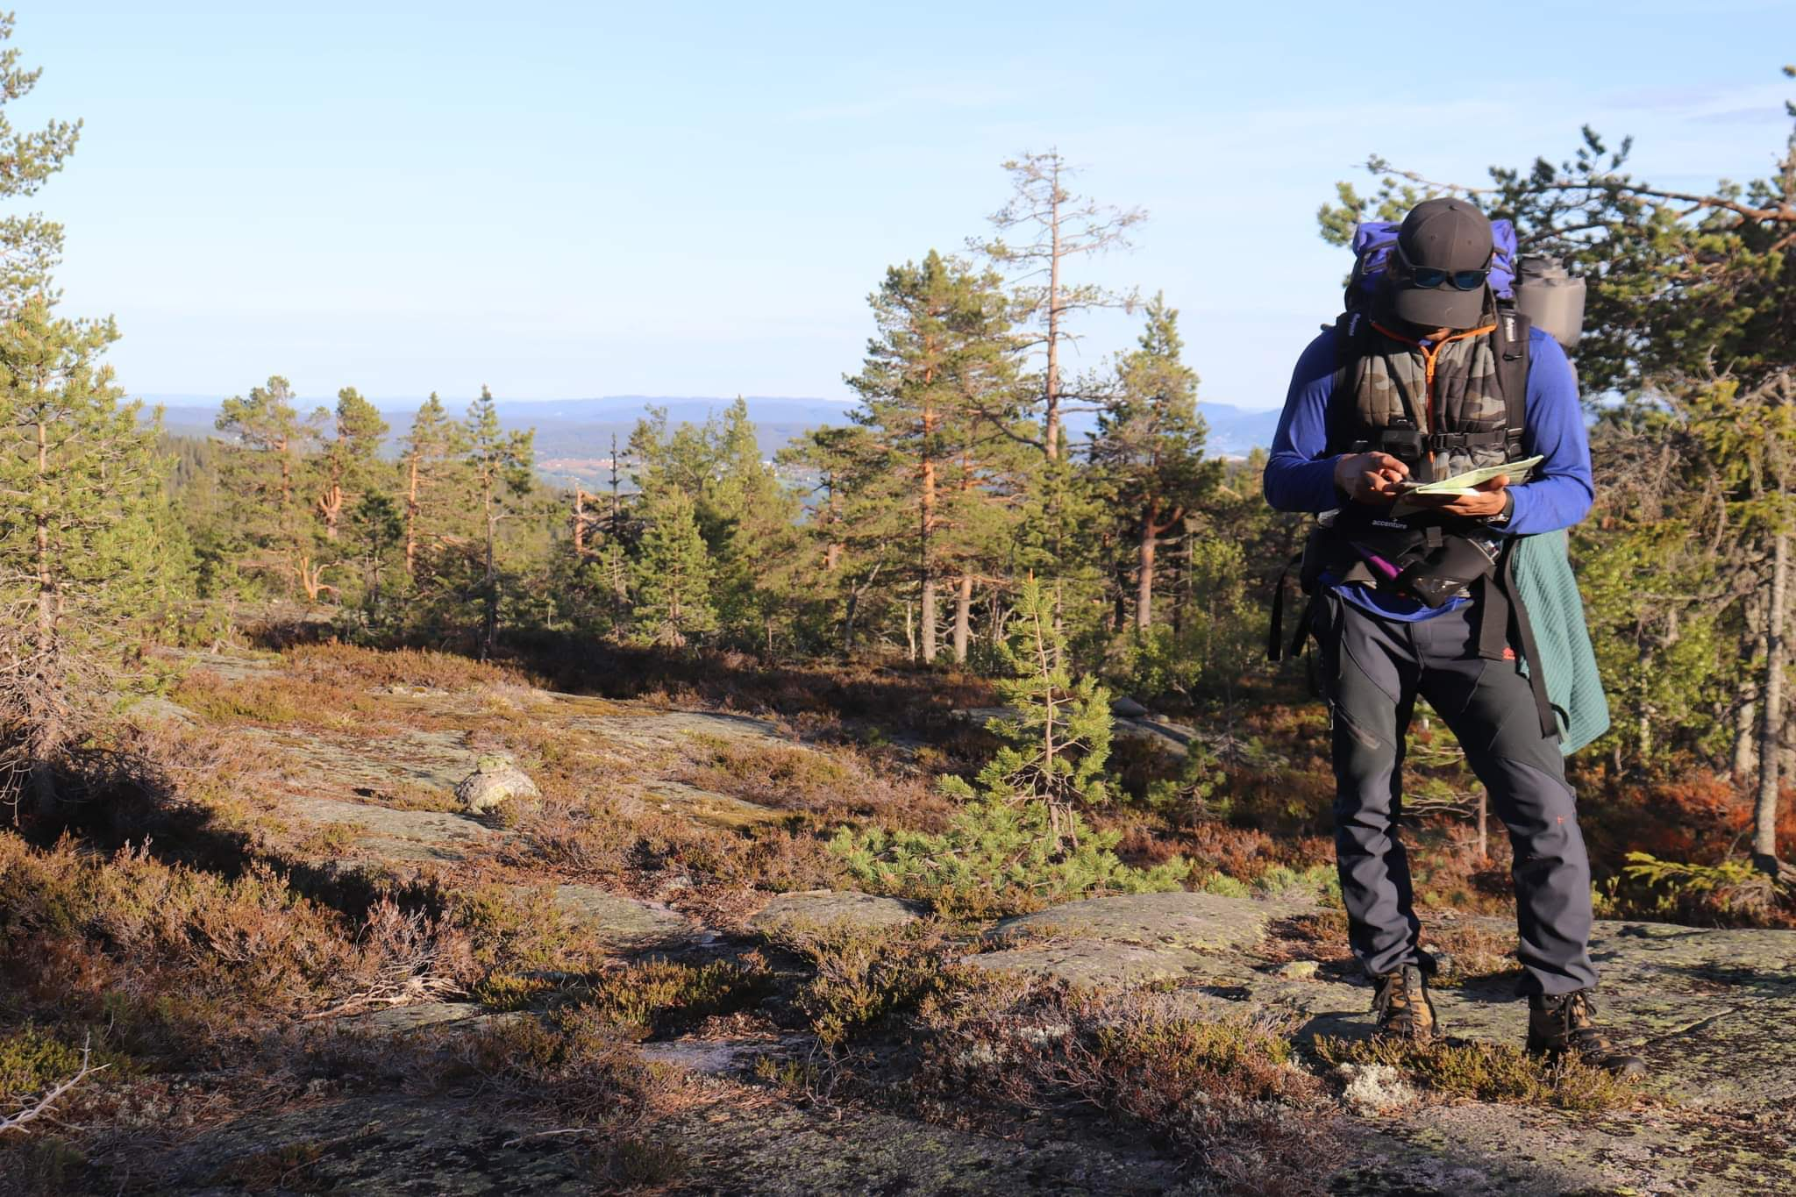














Sai Prudhvi Neelakantam
Data Engineer by❤️
Consultant @
Building ETL pipelines, crunching data & driving insights
Masters in Business Analytics
4+ Certified by Microsoft & Databricks
Hiking, Skiing, Training & Board games
Geek in Data & AI
in/saiprudhvineelakantam
geekindata.com
Oslo
Norway
sai@geekindata.com

Slide 4
THANK
YOU
FOR CHOOSING TO BE HERE!

Slide 5
Near-Real-Time Object Recognition using Azure AI and Microsoft Fabric
Sai Prudhvi Neelakantam

Slide 6

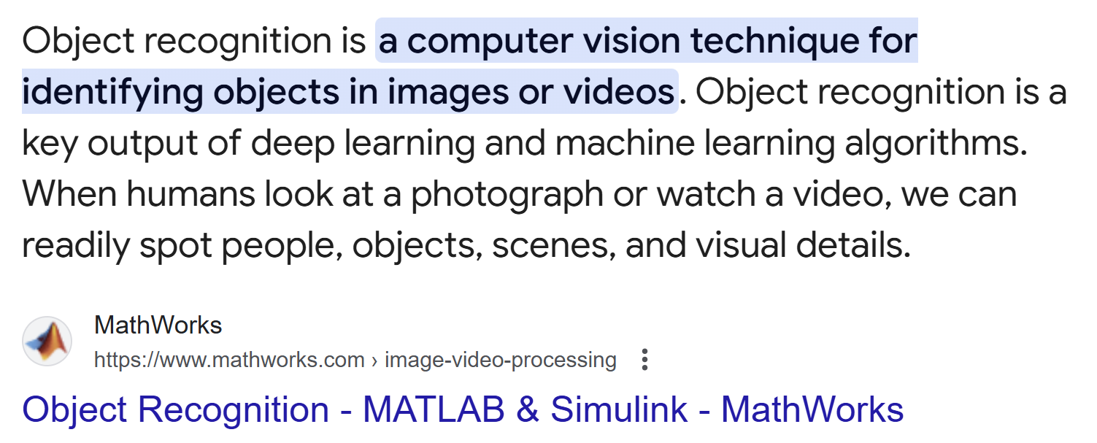
Near-Real-Time Object Recognition using Azure AI and Microsoft Fabric | Sai Prudhvi Neelakantam
Data Community Austria Day 2025, Vienna

Slide 7

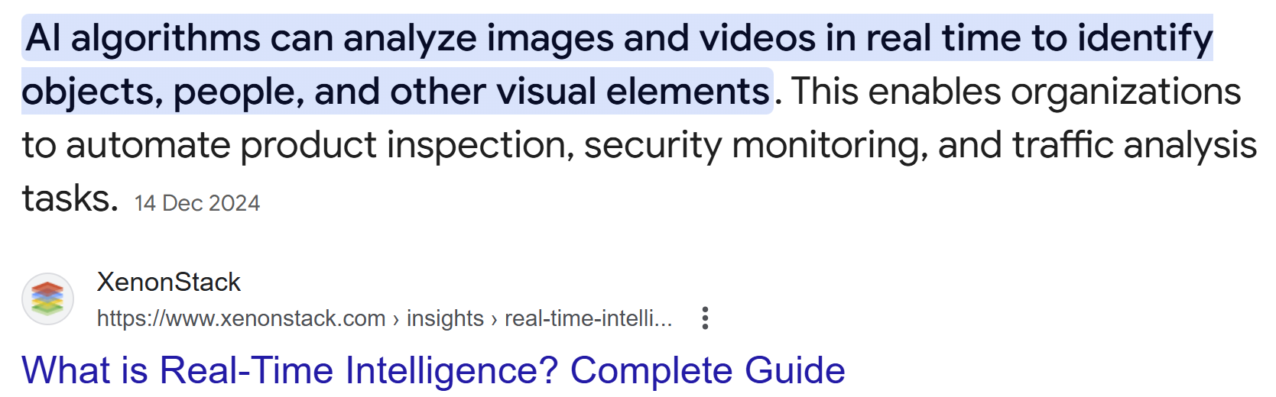
Near-Real-Time Object Recognition using Azure AI and Microsoft Fabric | Sai Prudhvi Neelakantam
Data Community Austria Day 2025, Vienna

Slide 8
Real-Time Object Recognition Use Cases?
Near-Real-Time Object Recognition using Azure AI and Microsoft Fabric | Sai Prudhvi Neelakantam
Data Community Austria Day 2025, Vienna

Slide 9
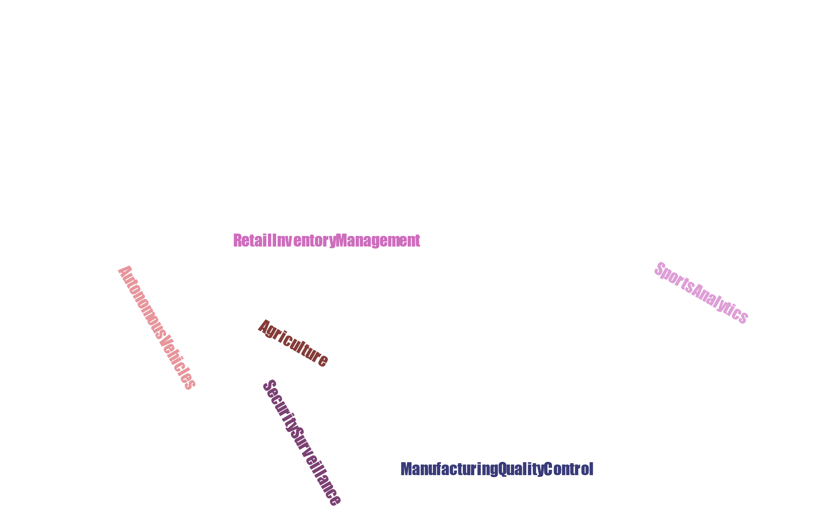
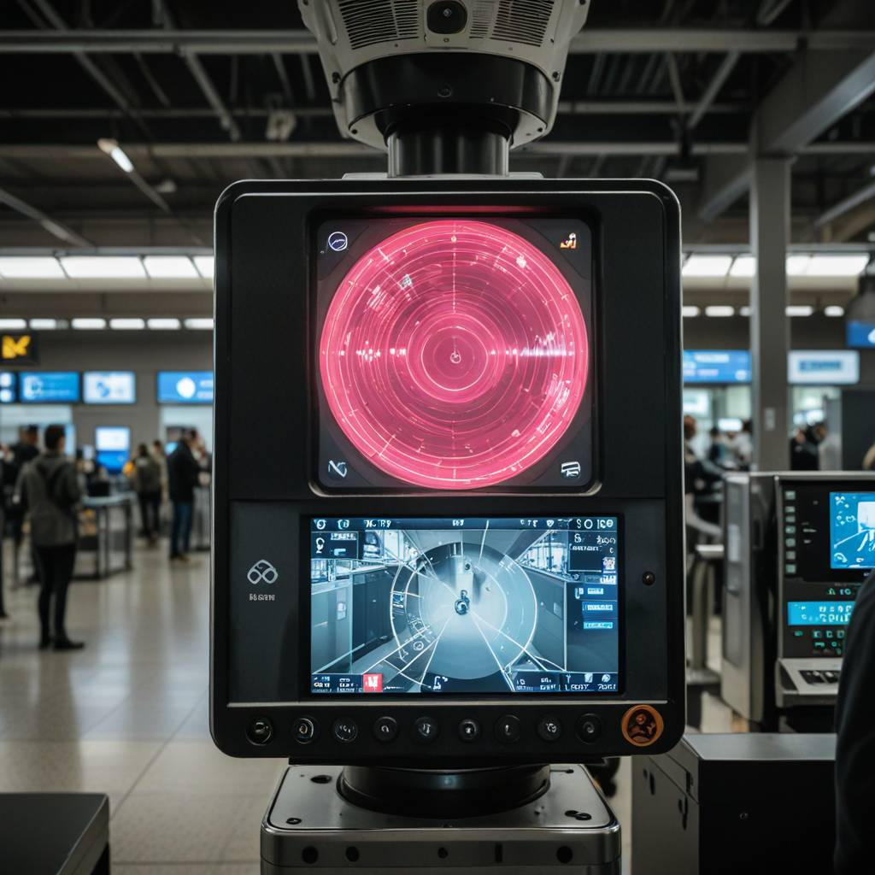



Real-Time Object Recognition Use Cases?
Airport Security Surveillance
Azure AI
Services
Microsoft
Fabric
Near-Real-Time Object Recognition using Azure AI and Microsoft Fabric | Sai Prudhvi Neelakantam
Data Community Austria Day 2025, Vienna

Slide 10
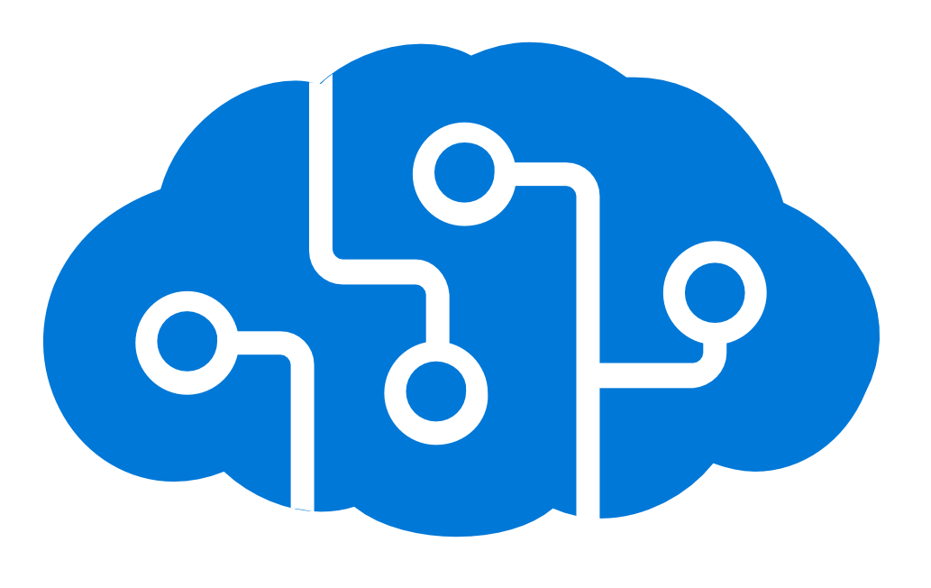
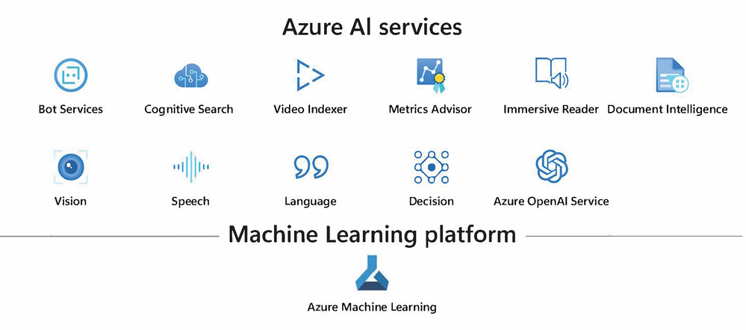
Azure AI Services
Azure AI Studio
Near-Real-Time Object Recognition using Azure AI and Microsoft Fabric | Sai Prudhvi Neelakantam
Data Community Austria Day 2025, Vienna

Slide 11
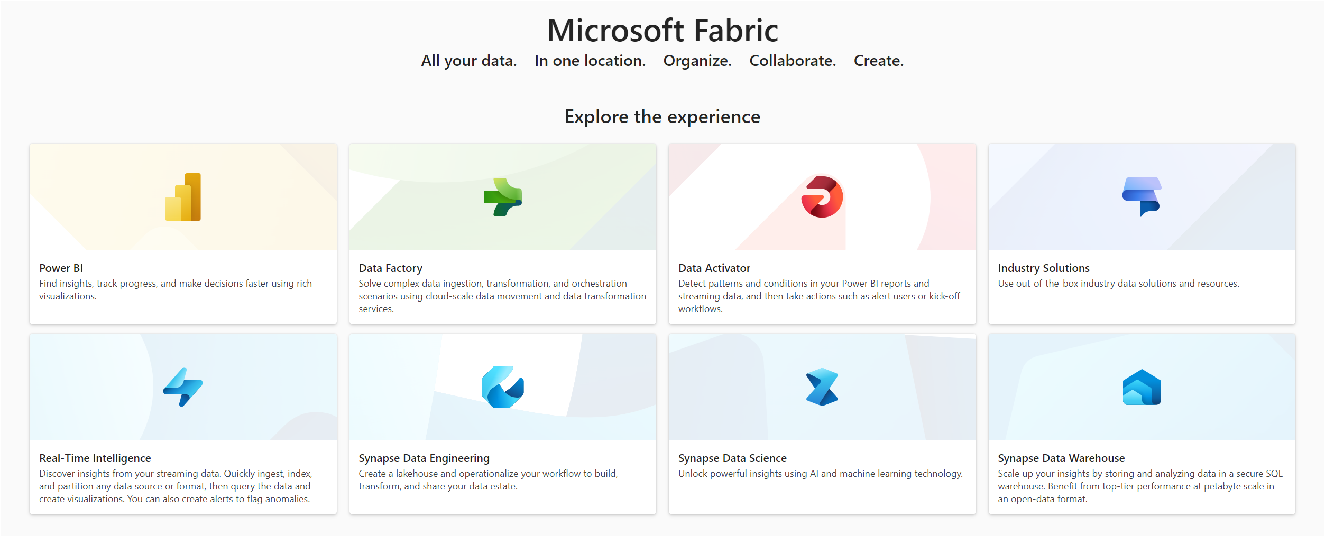
Microsoft Fabric
Near-Real-Time Object Recognition using Azure AI and Microsoft Fabric | Sai Prudhvi Neelakantam
Data Community Austria Day 2025, Vienna

Slide 12
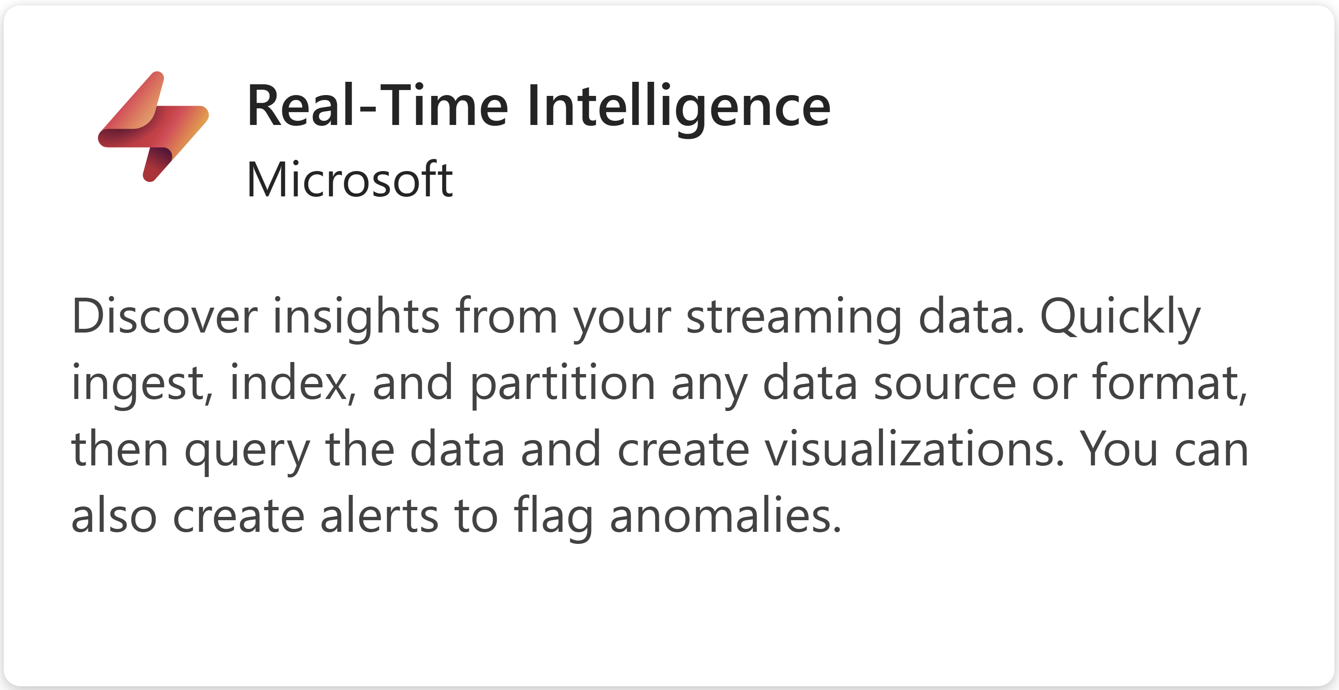
Microsoft Fabric
Near-Real-Time Object Recognition using Azure AI and Microsoft Fabric | Sai Prudhvi Neelakantam
Data Community Austria Day 2025, Vienna

Slide 13
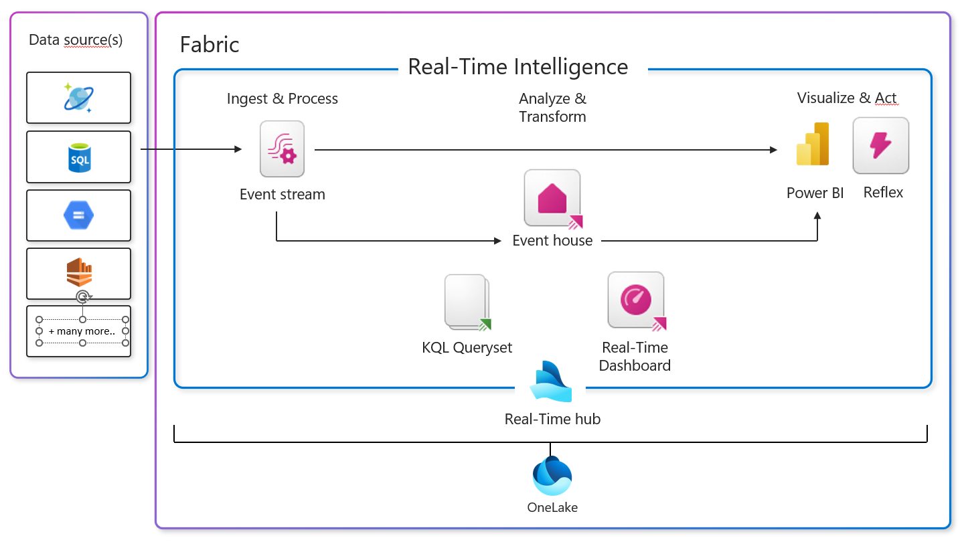
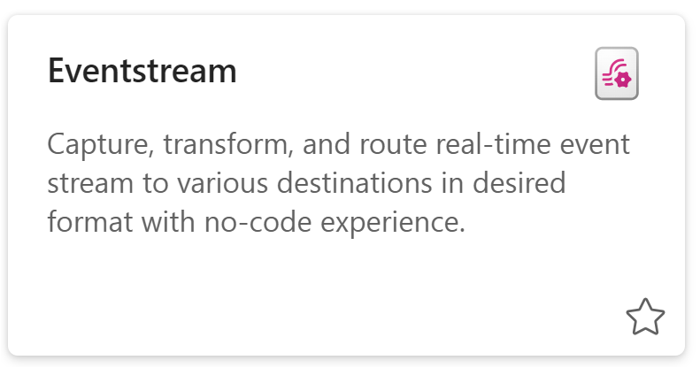
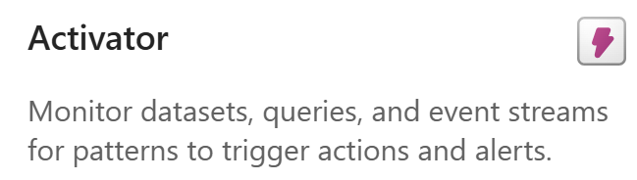
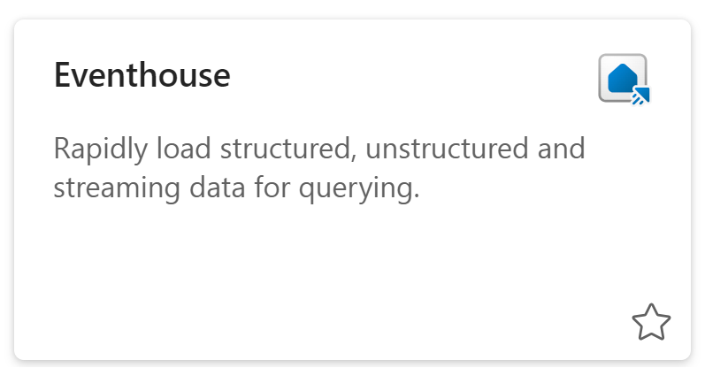
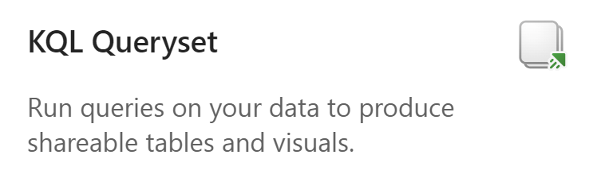
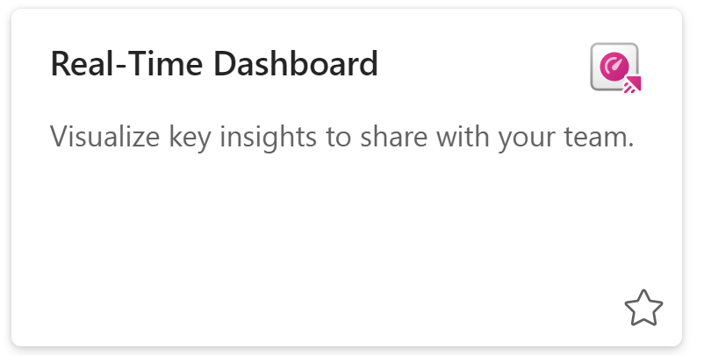

Items in Fabric Real-Time Intelligence
Activator
Near-Real-Time Object Recognition using Azure AI and Microsoft Fabric | Sai Prudhvi Neelakantam
Data Community Austria Day 2025, Vienna

Slide 14
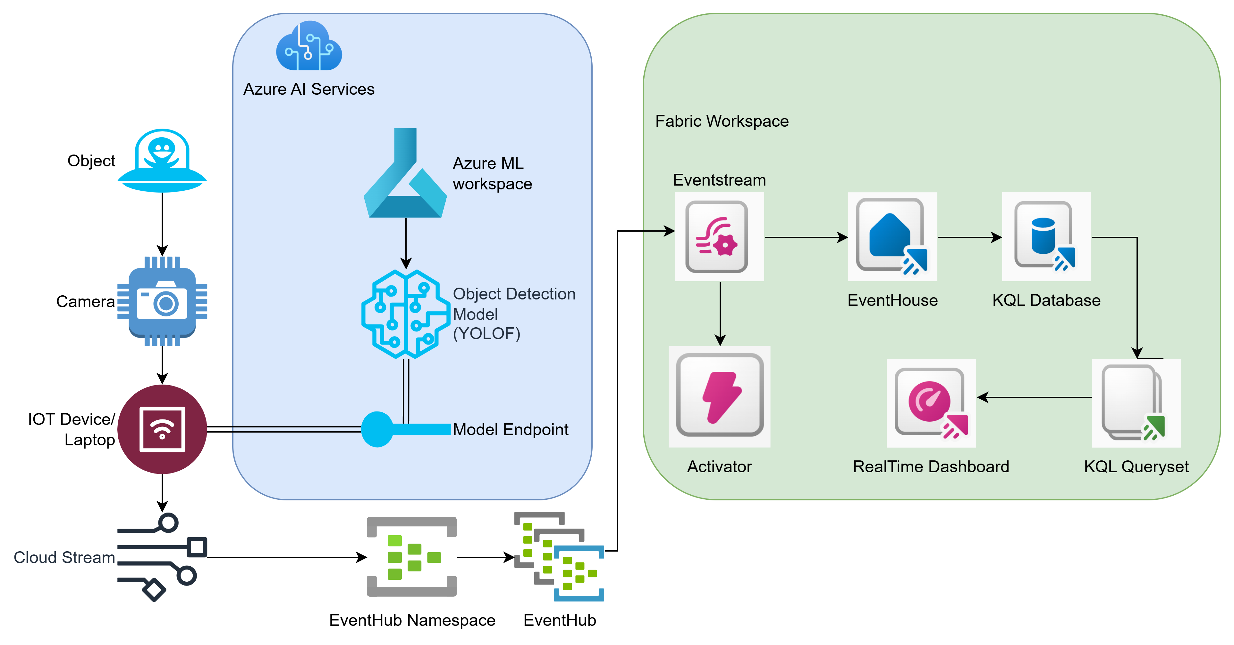

Architecture
YOLOF
Why Choose YOLOF?
Trained on COCO dataset with 1.5 million object instances primarily for object segmentation.
Simplicity - Uses a single layer for detection, making it easier and faster.
Performance - Delivers high accuracy and speed – 2.5x faster times than RetinaNet.
Near-Real-Time Object Recognition using Azure AI and Microsoft Fabric | Sai Prudhvi Neelakantam
Data Community Austria Day 2025, Vienna

Slide 15
AI/ML Model YOLOF (You Only Look One-level Feature)
Training and
Evaluation
Dataset: Trained on the widely-used COCO dataset.
Accuracy: Achieves a respectable box AP of 37.5.
User-Friendly
Easy to Use: Provides scripts for real-time and batch inference, and for finetuning on your own dataset.
Visual Results
Clear Outputs: Detects objects in images with clear bounding boxes, labels, and confidence scores.
Why Choose YOLOF?
Simplicity: Uses a single layer for detection, making it easier and faster.
Performance: Delivers high accuracy and speed.
Efficiency: Faster than many other models, like RetinaNet and YOLOv4, and requires less training time.
Near-Real-Time Object Recognition using Azure AI and Microsoft Fabric | Sai Prudhvi Neelakantam
Data Community Austria Day 2025, Vienna

Slide 16
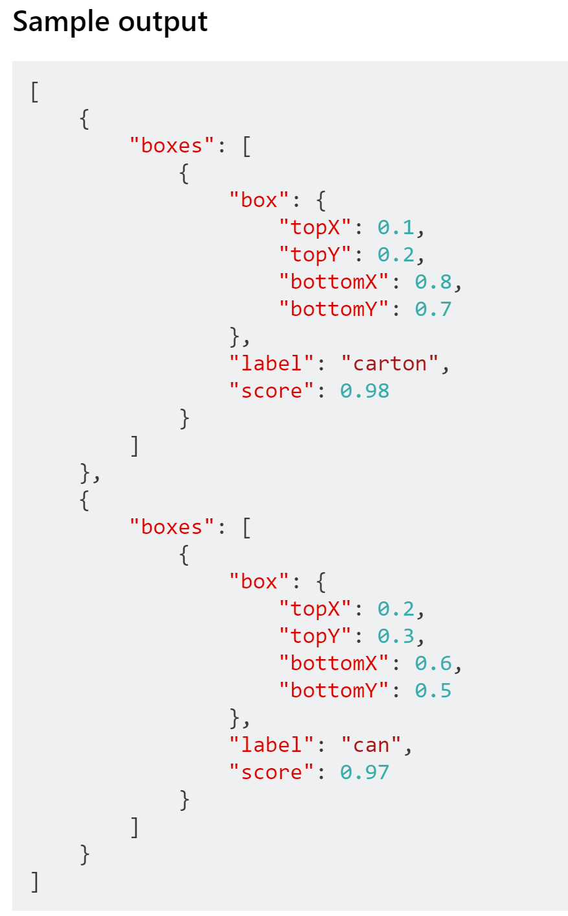
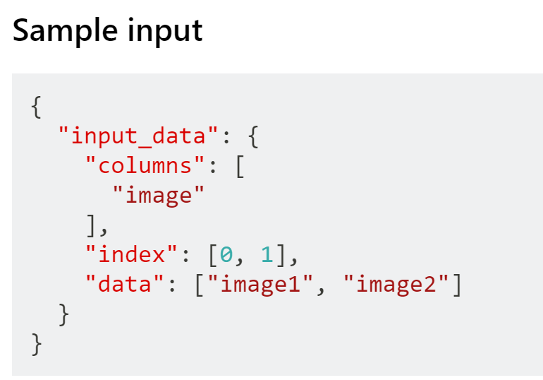
Sample Input and Output for YOLOF (You Only Look One-level Feature)
Near-Real-Time Object Recognition using Azure AI and Microsoft Fabric | Sai Prudhvi Neelakantam
Data Community Austria Day 2025, Vienna

Slide 17
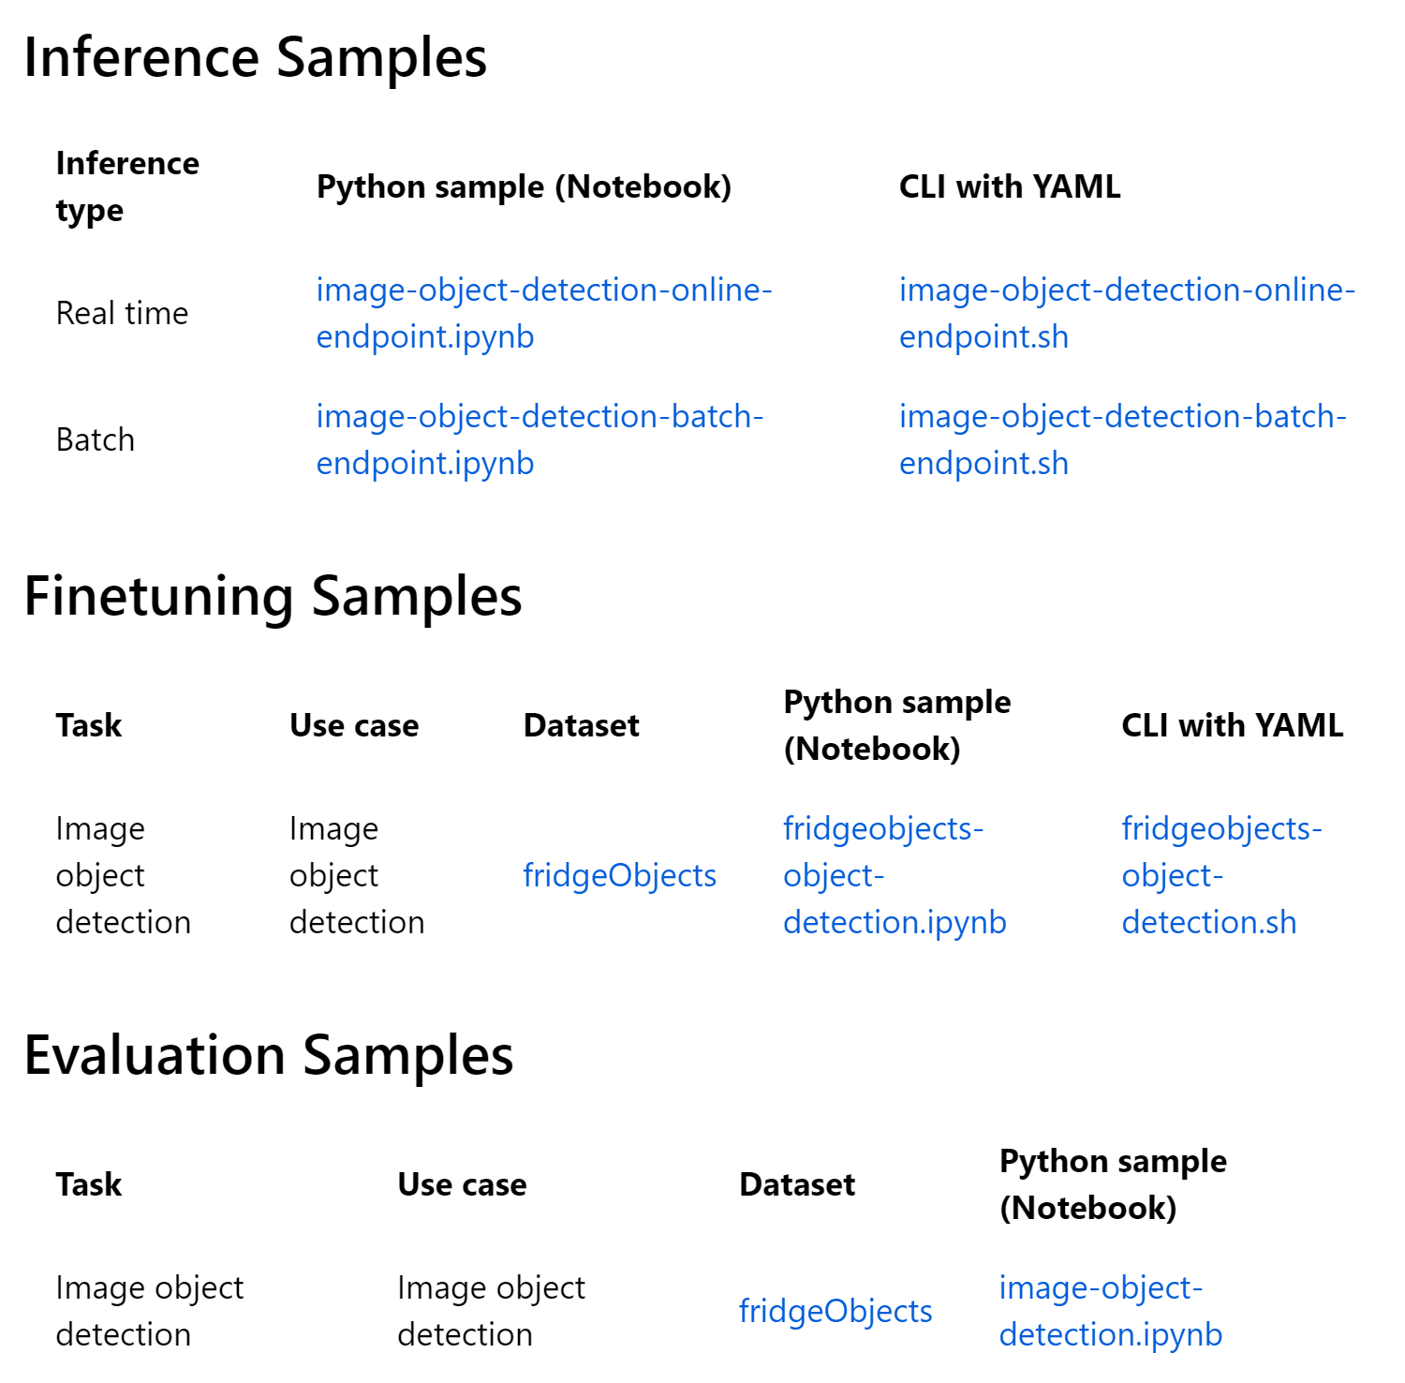
Prebuilt notebooks for model deployment in Azure ML
Near-Real-Time Object Recognition using Azure AI and Microsoft Fabric | Sai Prudhvi Neelakantam
Data Community Austria Day 2025, Vienna

Slide 18
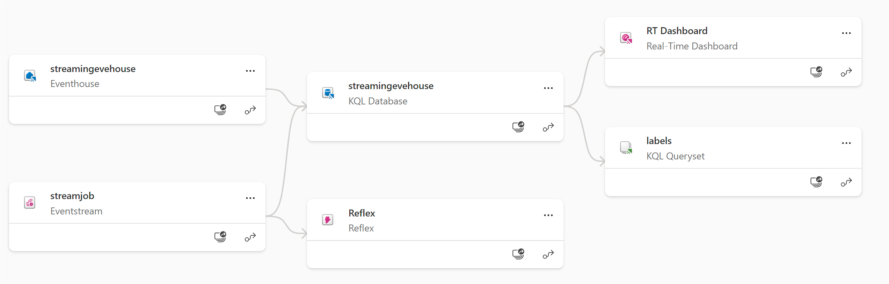
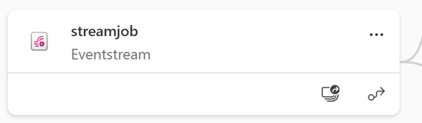
Fabric Realtime Intelligence Lineage
Near-Real-Time Object Recognition using Azure AI and Microsoft Fabric | Sai Prudhvi Neelakantam
Data Community Austria Day 2025, Vienna

Slide 19
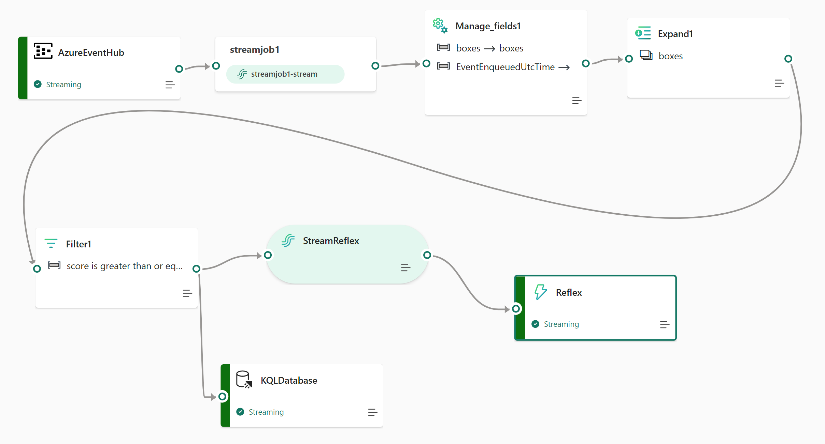
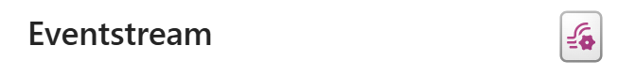
Fabric Eventstream
Near-Real-Time Object Recognition using Azure AI and Microsoft Fabric | Sai Prudhvi Neelakantam
Data Community Austria Day 2025, Vienna

Slide 20
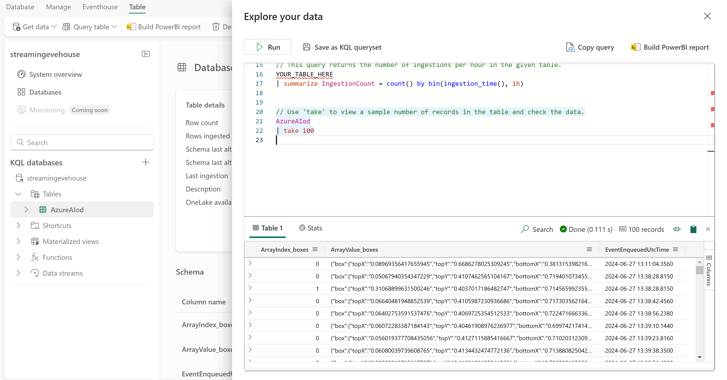

KQL Database in Eventhouse
Near-Real-Time Object Recognition using Azure AI and Microsoft Fabric | Sai Prudhvi Neelakantam
Data Community Austria Day 2025, Vienna

Slide 21
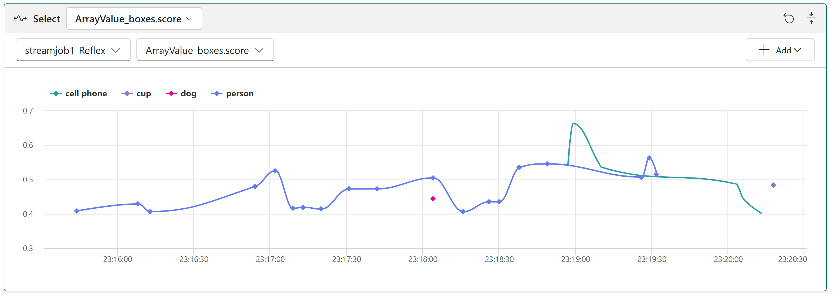

Fabric Reflex
Near-Real-Time Object Recognition using Azure AI and Microsoft Fabric | Sai Prudhvi Neelakantam
Data Community Austria Day 2025, Vienna

Slide 22
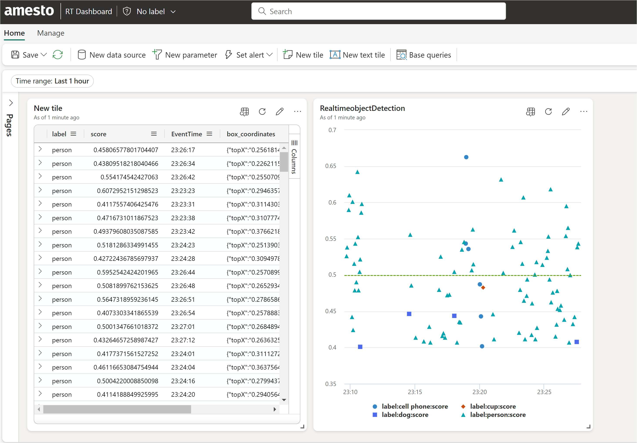

Fabric Realtime Dashboard
Near-Real-Time Object Recognition using Azure AI and Microsoft Fabric | Sai Prudhvi Neelakantam
Data Community Austria Day 2025, Vienna

Slide 23
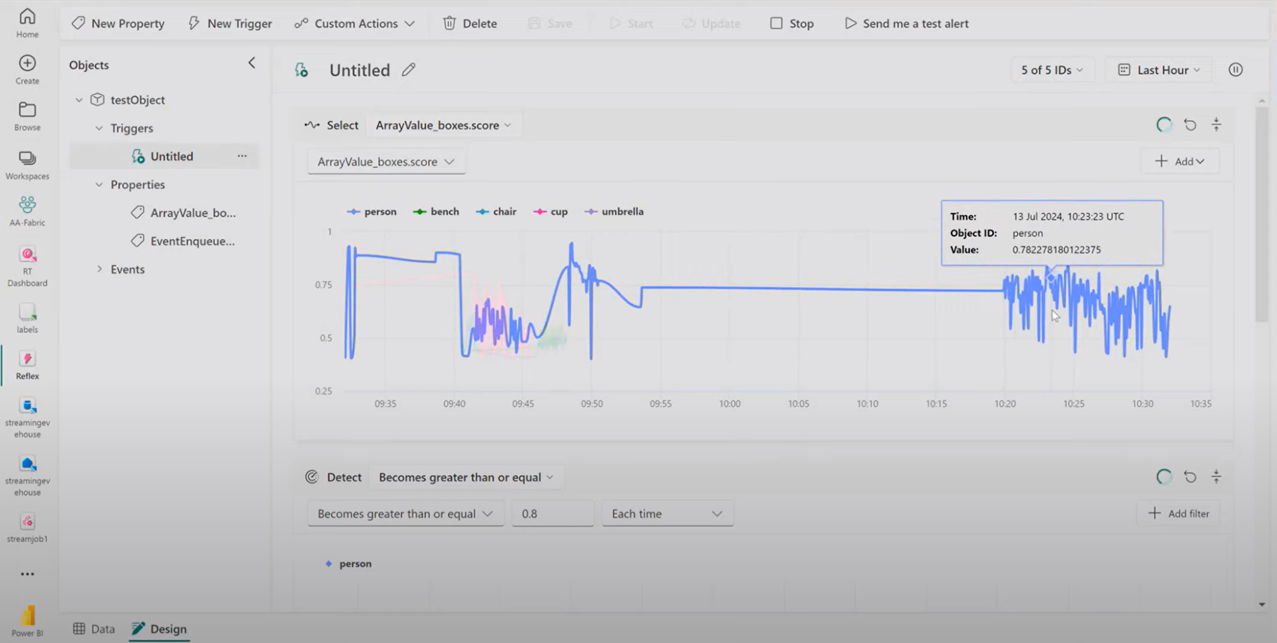
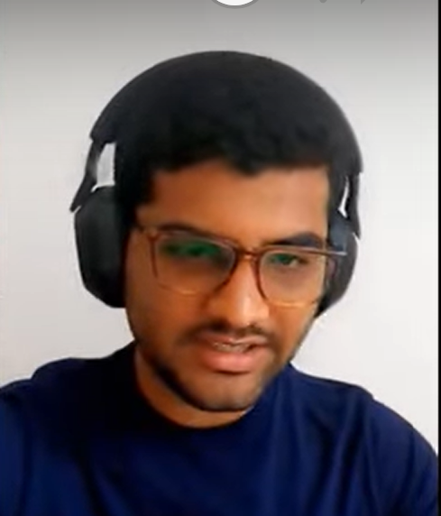

Slide 24
Recap Questions? Now is the time!
Near-Real-Time Object Recognition using Azure AI and Microsoft Fabric
Near-Real-Time Object Recognition using Azure AI and Microsoft Fabric | Sai Prudhvi Neelakantam
Data Community Austria Day 2025, Vienna

Slide 25
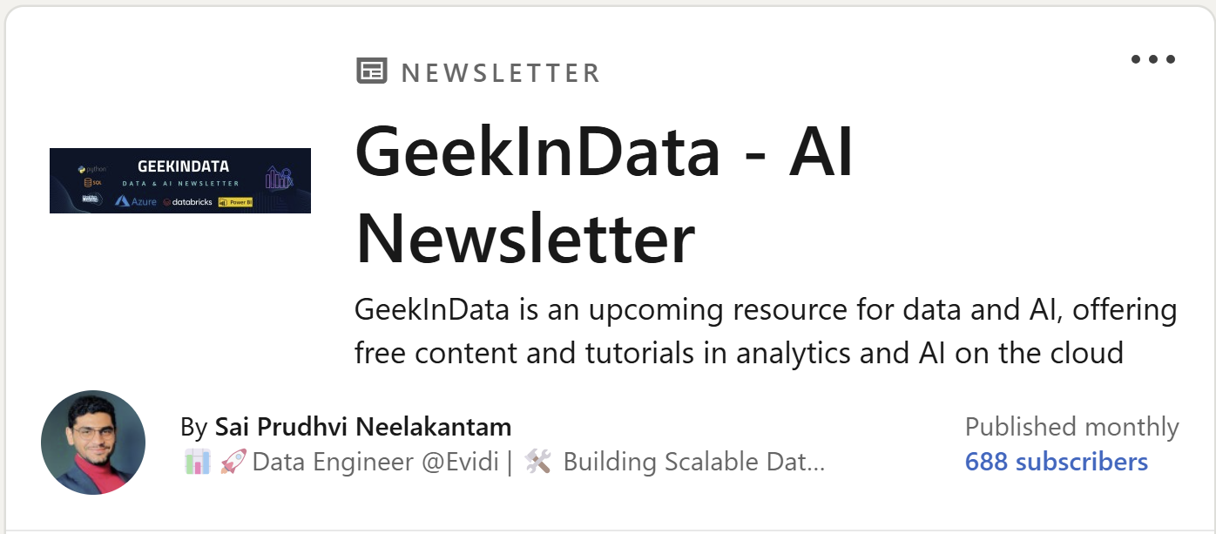
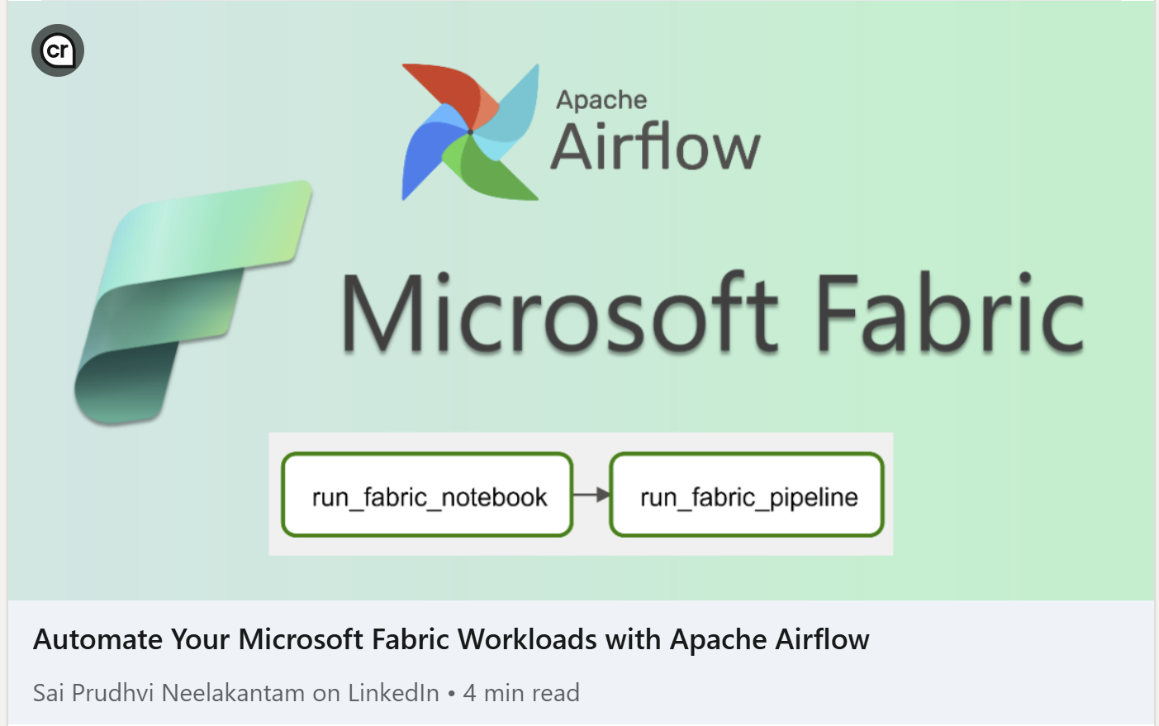
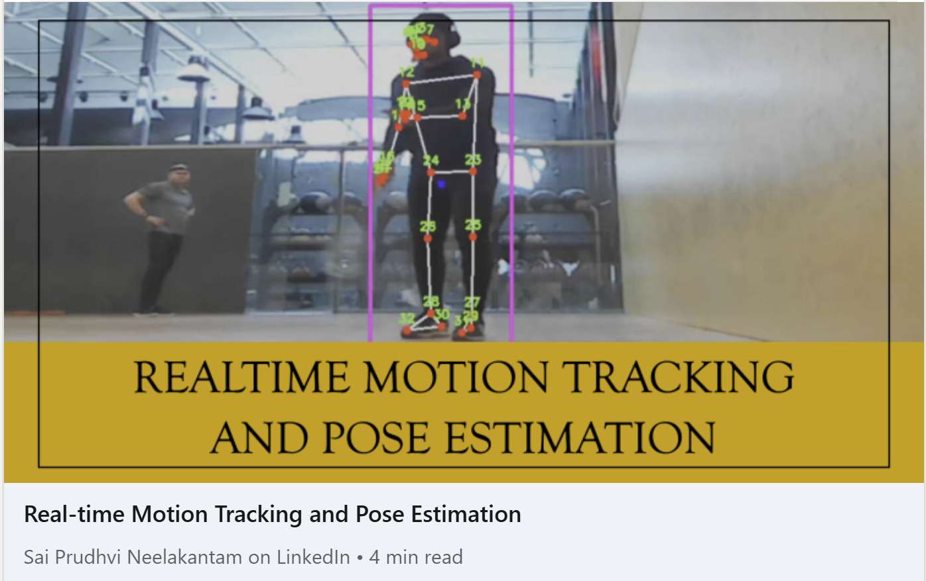
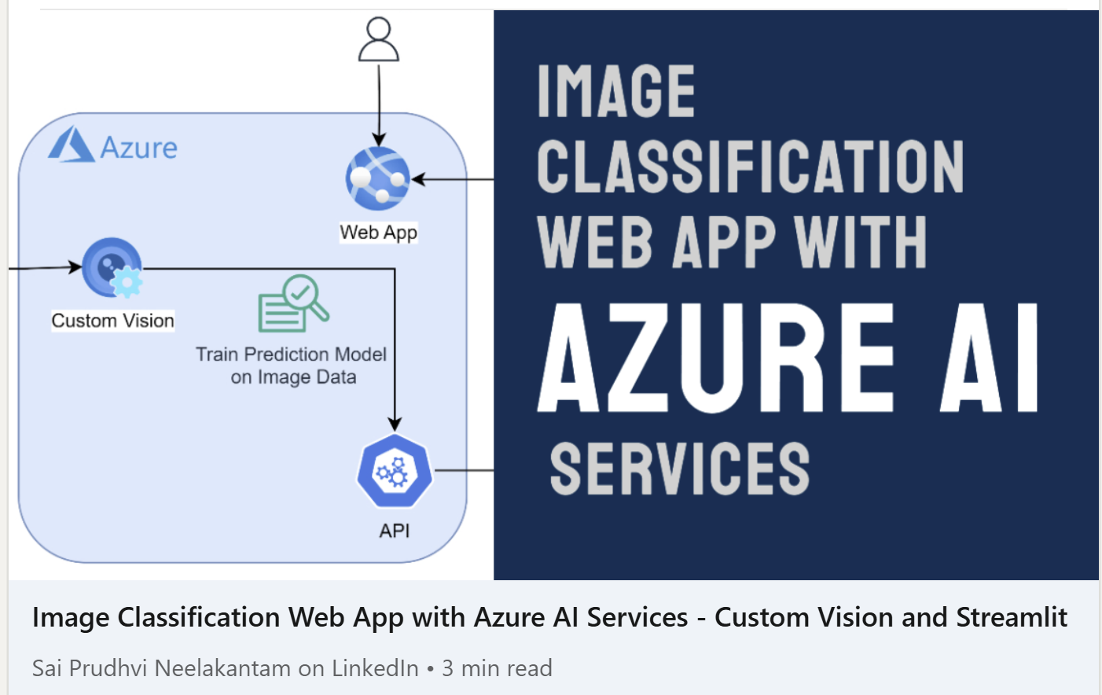

Slide 26
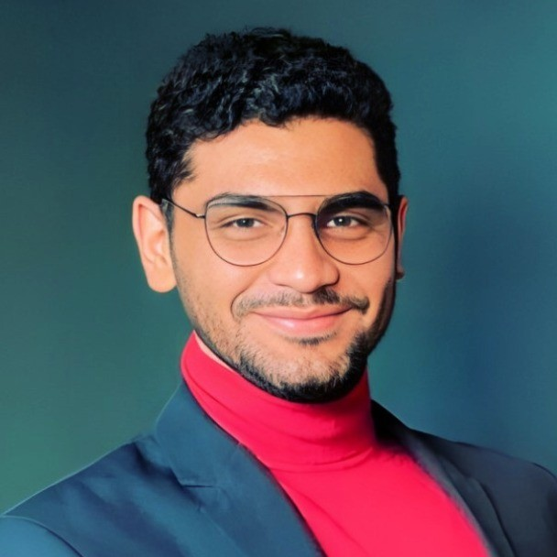
THANK YOU!
Data Community Day Austria 2025
Vienna
Sai Prudhvi Neelakantam
geekindata.com
sai@geekindata.com

Slide 27
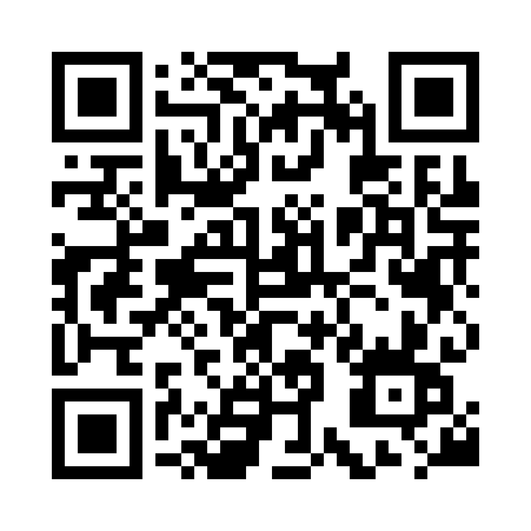
Your feedback and comments about this session are truly valuable to me. Please share your thoughts, I greatly appreciate it! Thank You!

